Slide 1
GSAPP Grant Supports and Policies:
We are here to support your research, innovations and scholarship!
Webinar
March 14 2022

Slide 2
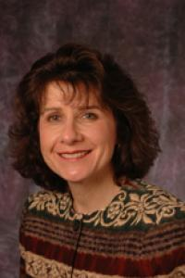
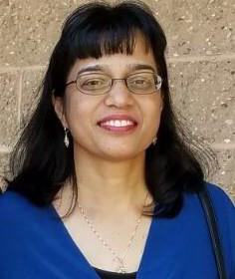
Welcome to the GSAPP Grants Office Team !
Linda Reddy
Jayshree Mariwala
Girjadai Ramsaroop

Slide 3
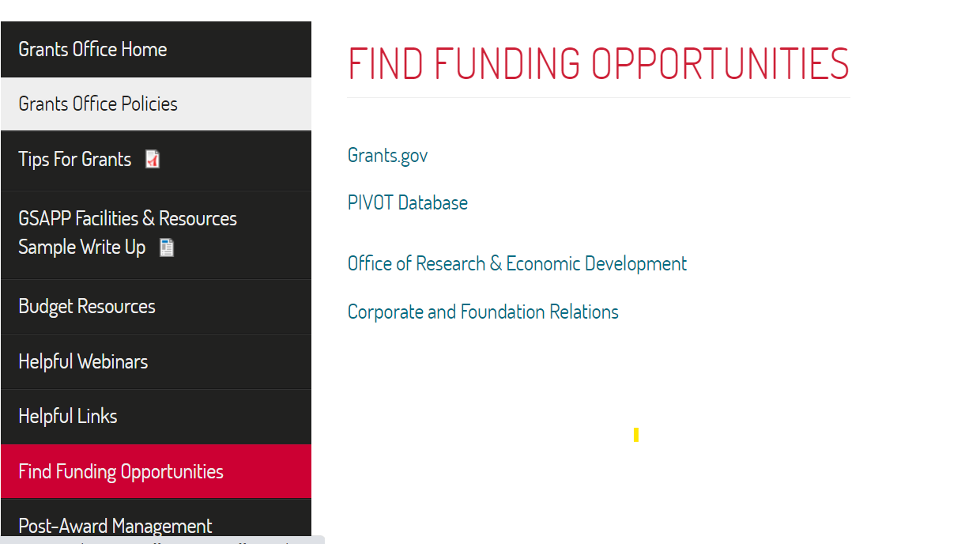
Find Funding Opportunities
Email alerts from the GSAPP Grants Office
https://gsapp.rutgers.edu/grants-office/find-funding-opportunities

Slide 4
Moving Forward on your Grant Proposal

Slide 5
Working as a Team is Key

Slide 7
Pre Award Communications
PI must contact the grants office at least six weeks prior to the proposal submission deadline and provide program guidelines. This will provide the grants office staff enough time to provide submission support.
Grants office (Jayshree) manages all communications and questions directly with RSP representative for grant submissions. Grants office (Jayshree) will include PIs on all email communications with RSP. PIs do not need to directly contact RSP.
The grants office will be flexible when grant opportunities are posted with short submission windows (i.e., 45 days or less).
Note: Official Exemption Request to the Vice President for Research will be the responsibility of the PI when not in compliance with RSP deadlines.

Slide 8
Deadlines
Please refer to proposal submission matrix on RSP (Research & Sponsored Program) website to compile with University submission deadlines https://research.rutgers.edu/researcher-support/research-and-sponsored-programs/proposal-and-submission-preparation/deadlines
RSP Five (5) Business Day Deadline:
Completed RAPSS Funding Proposal with all required signatures/department approval and final project title.
Sponsor's guidelines.
Final proposal excluding Final Science
Final budget with budget justification

Slide 9
Deadlines
Other Documents as requested by the sponsor program announcement/solicitation(Bio sketches, C.V, Current & Pending support, Bibliography & References Cited, Facilities & Other Resources, Equipment)
Subaward documents (if applicable): - Budget - Budget Justification - Scope of Work - Letter of Intent or Subrecipient Commitment Form (please see Subaward Preparation for applicability of the appropriate form)

Slide 10
Deadlines
Two (2) Business Day Deadline:
Completed electronic Conflict of Interest disclosure (eCOI): For all Investigators, a disclosure must be on file and active (submitted within the last 12 months) at the time of proposal submission. A new disclosure is not required.
Final Science, which may include: - Project Summary/Abstract - Project Narrative - Bibliography & References Cited - Facilities & Other Resources - Specific Aims - Research Strategy - Resource Sharing Plan(s) - Other, as required by the Sponsor

Slide 11
Pre Award Communications
Grants office understands that PIs will make revisions to the final narrative and appendices up until the grant deadline. PIs will communicate via email with the grants office (Jayshree).
Communications
Grants office (Jayshree) will communicate directly with RSP representative (2 business days before deadline) on their completion of their final narrative revisions and uploading of final documents. After PIs approve, the RSP representative will submit the final grant package to the funder.
Grants that requires submission via sponsor electronic system, such as NSF Fastlane, Proposal Central, or via foundation portal. If the system permits, RSP/Grants office should be given access.

Slide 12
Pre Award Budget
GSAPP Budget Approval: Proposal budget must be submitted for approval to the GSAPP Business Office 10 days prior to submission deadline.
Budget and Budget Justification: Grants Office will provide assistance.
Indirect Cost is determined as per the agreement between Rutgers University-NB and the federal government, sponsor guidelines, and university policy.
GSAPP F&A policy: Any proposal with F&A less than the On Campus negotiated rate of 57% will require the Deans approval. The approval request are required at least 15 business days prior to submission deadline. Each proposal will be evaluated on an individual basis.
Proposals that allow budgeting support for the grants office (e.g., 5% to full salary support) are required to do so. Budgeting for grant office support may not apply to small grants such a foundation grants or federal and/or state grants that do not permit business support.

Slide 13
Pre Award Budget
Sub Award documentation: PI must provide subaward institution contact information to enable the grants office to coordinate the submission and internal compliance documents required by ORSP. The subaward institution is responsible to submit a budget as per the sponsor guideline and in the required budget format.
Just‐In time: The Grants office will work with the PI and ORSP in gathering the Just‐In Time documentation or any other sponsor requested documents, once the PI has initiated the request. Since these documents are uploaded into the PI’s eRA‐Commons or NSF Fastlane account and are time sensitive, the PI, ORSP and Grants Office will work in unison to submit these documents.
Cost Share is determined as per sponsor guideline. Cost sharing can include financial obligations (GSAPP funds) or in kind effort/resources (e.g., 12.5% effort course release, student support – 1st year fellow). Cost sharing must receive prior approval from the Dean.
Course buy‐out: One course buy‐out (12.5 percent of faculty base salaries plus percentage of University fringe/benefits) need written approval from the Department Chair and the Dean.

Slide 14
Pre Award Supports
Non‐science documents: Grants office will provide guidance regarding format and page limit.
Bio‐Sketch: Grants office will review and provide guidance to the PI and their staff in developing their bio‐sketches based on the sponsor guidelines. PI must provide PMCID numbers for publications if required, and current and pending grant support information in the requested format. PIs must check the funder’s requirements for formatting updates.

Slide 15
Pre Award Supports
RAPSS: All grant submission requires RAPSS Funding Proposal. Grants office will provide assistance with generating the Funding Proposal in RAPSS and provide a link to sponsor submission documents.
Proposal Documents: Grants office will provide assistance in uploading the budget and budget justification, and other non‐science documents on the sponsor submission forms. All other documents must be uploaded by the PI or their staff in the requested format to avoid any error due to PDF conversions or last minute document revisions.
RSP: PIs must be available to provide any correction requested by RSP specialist during the final review period, 2 days’ prior for submission date. Grants office will work with the PIs to facilitate these corrections.

Slide 16
CONGRATULATIONS YOU GOT THE GRANT !! GSAPP Post Award Administration Policies

Slide 17
GSAPP Post Award Administration Policies
Procurement: It is the responsibility of the PIs and their program staff to prepare purchase orders and service provider agreements with support from Usha. The assigned GSAPP project manager will review and approve the purchase order and service agreement in Market Place.

Slide 18
GSAPP Post Award Administration Policies
Quarterly Reconciliation: High‐level financial overview to assist with quarterly financial reconciliation. Project reconciliation reports will be provided to the PIs to review the net balance/deficit. It is the PI or their program staff’s responsibility to work with the Business staff to balance the project. Grant Office staff will not make any decision regarding cost transfers. They will review all expenses for compliance with sponsor, University and Federal guidelines.

Slide 19
GSAPP Post Award Administration Policies
Progress report: Preparation and uploading of the annual and final progress narrative reports are the PIs responsibility. Grants office is only responsible for the financial sections.
Funder Required Reports can be: annual, quarterly or monthly
Expense Reimbursement Policy: All expense reimbursements are to be uploaded into the system directly by the requestor. Due to the implementation for the new online system, we are still experiencing system errors. Please track your reimbursement requests in the system and contact your approver if the expense reports are not approved within 10 business days.

Slide 20
GSAPP Post Award Administration Policies
Financial Closing: Grants office will work with GCA/RSP in providing financial reports based on the schedule for the sponsor. The financial reports will be in the standard university format. Funding agencies that require customized budget reporting will be completed in collaboration with the grants office, PIs and their project staff. Once the reports are completed and approved by GCA/RSP, the customized sponsor report(s) will be e‐mailed to the grant sponsor by GCA/RSP and grants office (Jayshree) with the PIs being copied.

