Slide 1
Dissertations, Theses, and ADA Compliance

Slide 2
ADA Title II Regulations
Regulation:
Title II of the ADA requires state and local governments to ensure that their digital services (websites, mobile apps) are accessible to individuals with disabilities.
Standards Referenced:
WCAG 2.1 Level AA is the benchmark for technical compliance.
Compliance Deadline:
April 24, 2026

Slide 3
The GSAPP Dissertation Formatting Style Guide vs. ADA Regulations:
The GSAPP Dissertation Formatting Style Guide speaks mostly to APA formatting.
ADA regulations speak to the accessibility of the document.

Slide 4
Use of Text
Sans serif font (APA recommends Arial or Calibri)
12 pt font or larger
Do not utilize images of text
Strong contrast
  Why: Low contrast can make content hard to read or understand for users with visual impairments, including color blindness.
  WCAG requires normal text to be at least 4.5:1 and large text (18 pt or 14 pt bold and above) to be at least 3:1.
  Free contrast checker
  Hex Value for Black: 000000
  Hex Value for White: FFFFFF

Slide 5
Use of Color
Any information conveyed through color must also be paired with text or another visual indicator to ensure clarity.
Why: Color-only cues can make content hard to read or understand for users with visual impairments, including color blindness.
Don’t forget to check your contrast levels.

Slide 6
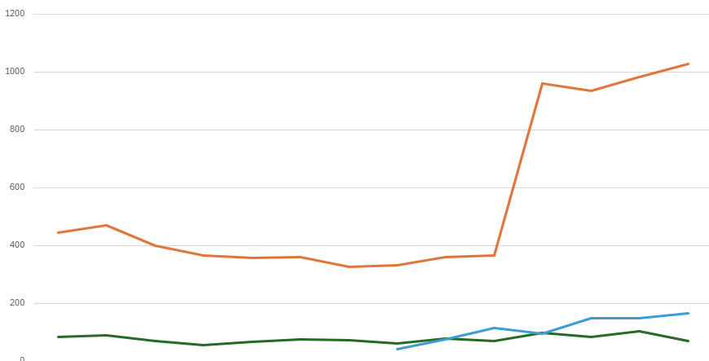
Use of Color – Non-compliant
Non-compliant

Slide 7
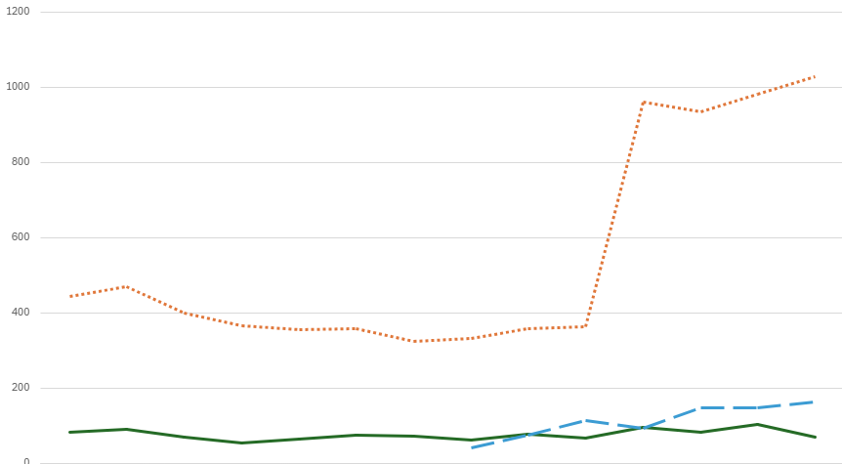
Use of Color - Compliant
Compliant

Slide 8
Shape, Size, and Position
Present content in a way that does not depend on references to shape, size or position for understanding.
Why: Relying on the shape, size, and position can make content hard to read or understand for users with visual impairments.

Slide 9
Heading Styles
Organize content using heading styles in a sequential order without skipping levels, to enhance readability.
Why: Headings provide structure and help screen readers navigate content
Use built-in heading styles (e.g., H1, H2) rather than changing font size or making text bold. Ensure your heading styles align with APA formatting requirements.

Slide 10
Tables
Create simple tables with clear column and row headers for better comprehension.
Only use tables to organize data, not for formatting purposes.
Why: Layout tables confuse screen readers and mobile users

Slide 11
Tables (continued)
Creating a table in another program (e.g., Excel, SPSS, etc.) and pasting it into a Word Doc will cause screen readers to read it as an image.
Remember to check your font size and contrast.
Steps to Creating an Accessible Table in Word

Slide 12
Alternative Text
Provide descriptive alternative text (alt text) for images, graphs, and charts to make them accessible to all users.
Why: Alt text conveys the purpose of an image to users who cannot see it.

Slide 13
Tips for Writing Alternative Text
Focus on the purpose of the image
  Describe its meaning in the context of the document
Be brief, specific, and concise
  One or two brief, specific sentences
Include key information and summarize data
  State the main takeaway
Avoid Redundancy
  Don’t repeat nearby text, or write “picture of…” or “graphic showing…”

Slide 14

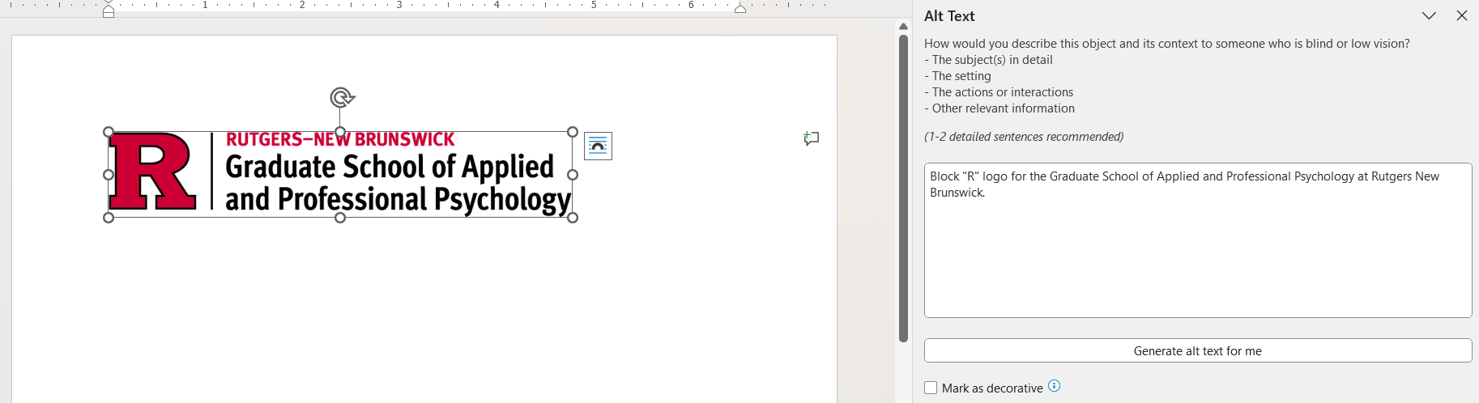
Alt Text Example

Slide 15
Links
Use descriptive text for external and internal links that clearly conveys the purpose of the link from the text alone.
Why: Screen readers often browse links out of context.
Avoid “click here” or “read more” as link text.
“Chapter One” or “Download Table 3” are examples of ADA-compliant links.

Slide 16
Accessibility Checkers
All Microsoft Products have an accessibility checker.
Double-check AI-generated alt text
Adobe Acrobat accessibility instructions.

Slide 17
Best Practices
Focus on basic items first:
  Use formatting styles
  Include alternative text or mark images as descriptive
Then move on to more complex concerns:
  Edit fonts to ensure they are clear and not overly stylistic
  Edit your headings styles to ensure the font is clear and the color of the fonts are high contrast colors (black is preferred on a white background)
  Double check that the alternative text is descriptive enough (if it is too long for the alt-text box, consider including the description in the body text).
Remember that accessibility checkers are not perfect, and manual checking will also be needed!
  Items to manually check include: page numbers, heading/reading order, language clarity, fillable text/forms

Slide 18
Free Screen Readers
Windows
  NVDA (NonVisual Desktop Access): A free, open-source, and widely used screen reader developed by NV Access, compatible with Windows 8.1 and later. It supports browsers (Firefox, Chrome), email, and office applications.
  Windows Narrator: A built-in screen reader available in Windows 10 and 11.
Apple
  VoiceOver: Built into all Apple devices

Slide 19
Additional Resource
Rutgers guide to making your ETD accessible

Slide 20
Questions?

